Slide 1
DEEP LEARNING NEURAL NETWORK

Slide 2

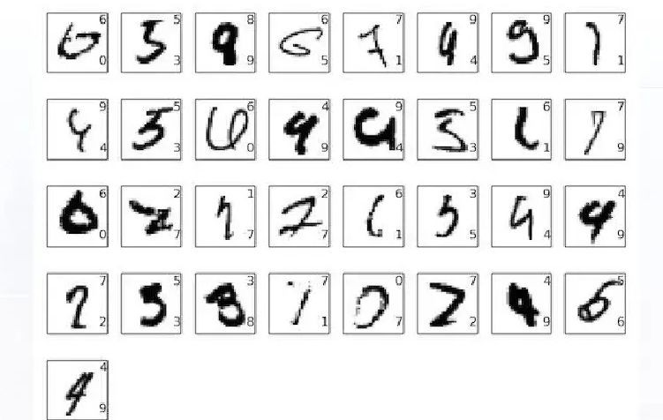
Handwritten Sequence
Human being effortlessly can recognize these digits
If we attempt to write computer program to recognize the digits, it is an Herculean task in the field of pattern recognition.

Slide 3
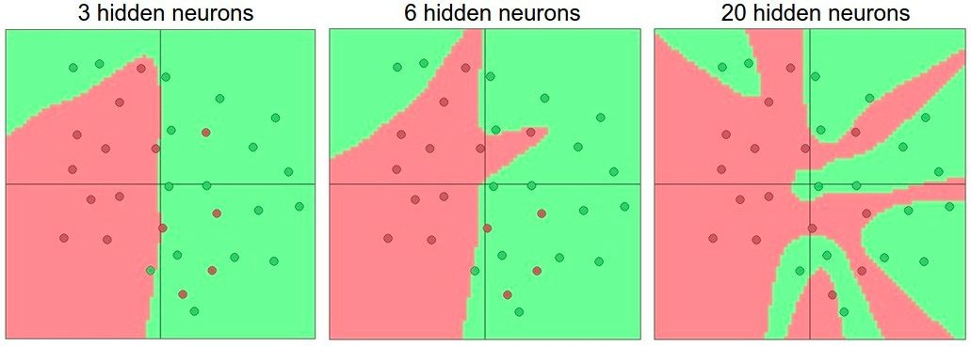
Why Deep Learning
Non-linearities needed to learn complex representations of data.
Deep learning algorithms attempt to learn data representation by using a hierarchy of multiple layers.
More layers and neurons approximate more complex functions

Slide 4
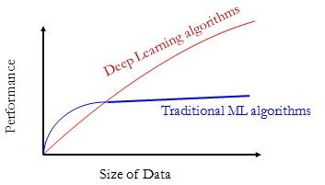
Performance Vs. Sample Size

Slide 5
Deep Learning
Deep learning models high-level abstractions by using a deep network with multiple processing layers, composed of multiple linear and non-linear transformation.
The term deep learning begins to gain popularity after a paper by Hinton on 2000
Deep learning based models learn representations of large-scale unlabeled data.
It replaces handcrafted features with efficient algorithms for feature learning and hierarchical feature extraction

Slide 6
Deep Learning
As we construct larger neural networks and train them with more and more data, their performance continues to increase.
This is generally different to other machine learning techniques that reach a plateau in performance.
Deep learning involves training a hierarchy of feature detectors in comparison to shallow learning models which rely on hand-crafted feature detectors.^{[6]}

Slide 7
Deep Learning
The first layer learns primitive features, occur more often, like an edge in an image or the tiniest unit of speech sound.
Once that layer learns the features, they are fed to the next layer to learn complex features, like a corner or a combination of speech sounds.
The process is repeated in successive layers until the system can reliably recognize phonemes or objects.
Drivers behind deep learning: huge amount of unstructured complex data increases performance with the size of the neural network.

Slide 8
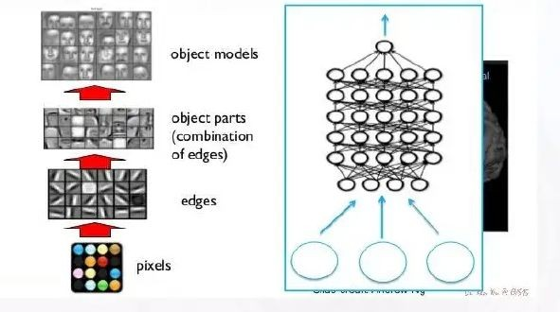

Slide 9
Neural Network
A neural network is a massively parallel distributed processor made up of simple processing units that has a natural propensity for storing experiential knowledge and making it available for use. ^{[2]}
It resembles the brain in two respects
1. Knowledge is acquired by the network from its environment through a learning process.
2. Interneuron connection strengths, known as synaptic weights, are used to store the acquired knowledge.

Slide 10
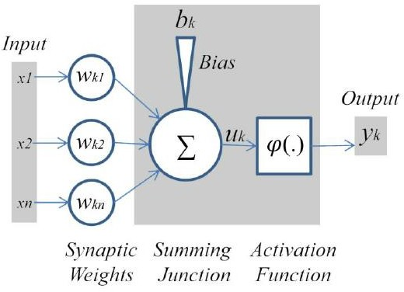
Nonlinear Model of a Neuron

Slide 11
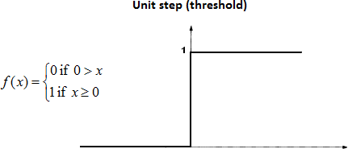
Activation Function (Threshold)

Slide 12
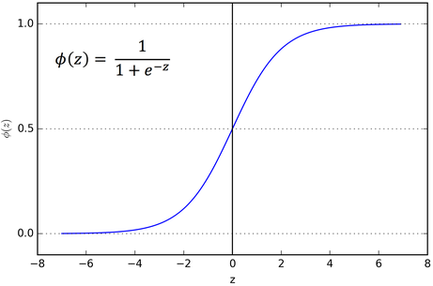
Activation Function (Sigmoid)
The sigmoid function saturates when its argument is very positive or very negative, meaning that the function becomes very flat and insensitive to small changes in its input.

Slide 13
Human Nervous System ^{[2]}
Stimulus
Receptors
Neural Net
Effectors
Response

Slide 14
Human Brain^{[2]}
Receptors – convert stimuli from the human body or the external environment into electrical impulses that convey information to the neural net (brain)
Neural Net – continually receives information, perceives it, and makes appropriate decisions
Effectors – convert electrical impulses generated by the neural net into discernible responses as system output
Arrows pointing from left to right indicate the forward transmission of information-bearing signals through the system
Arrows pointing from right to left signify the presence of feedback in the system

Slide 15
Feed forward Neural Networks
Multilayer Perceptrons
Deep Feedforward Networks
A feedforward network defines a mapping y = f (x; θ) and learns the value of the parameters θ that result in the best function approximation.
There are no feedback connections in which
outputs of the model are fed back into itself.
When feedforward neural networks are extended to include feedback connections, they are called recurrent neural networks.^{[7]}

Slide 16
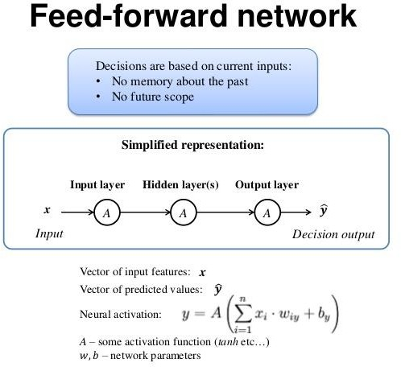
Feed-forward Network

Slide 17
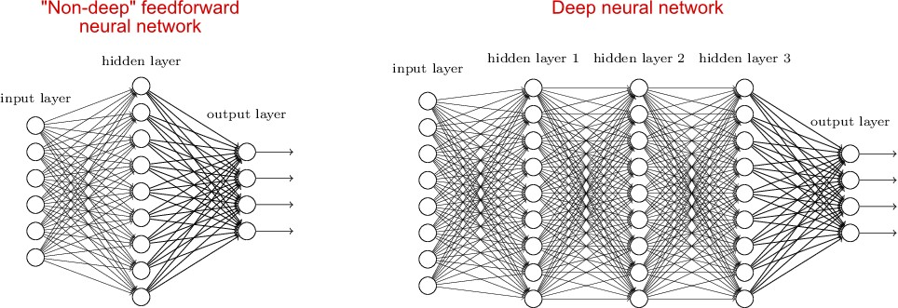
Feed Forward Neural Network

Slide 18
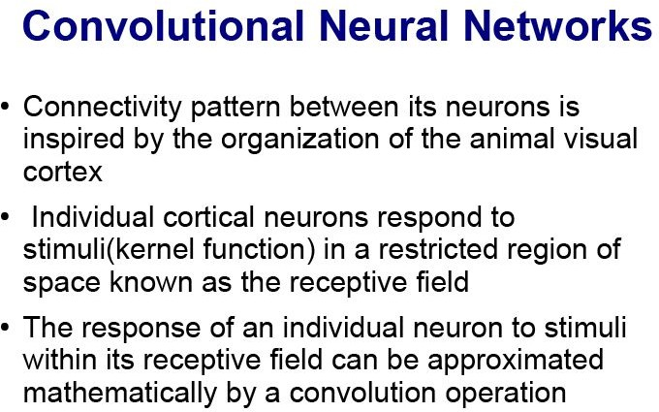

Slide 19
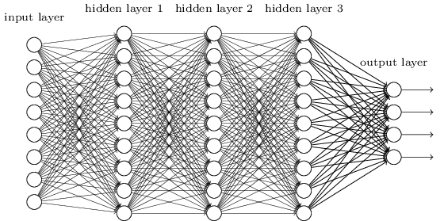
Convolution Neural Network
Do we really need all the edges of the network?
Can some of these be shared?

Slide 20
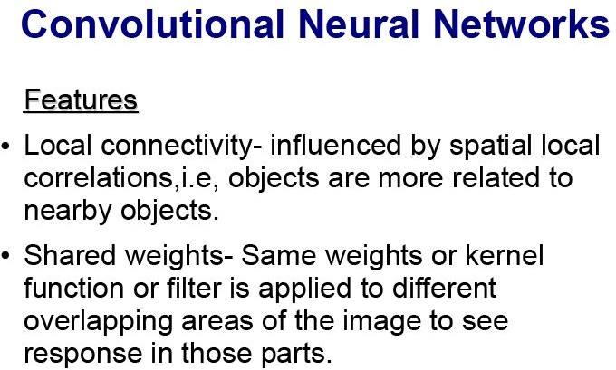

Slide 21
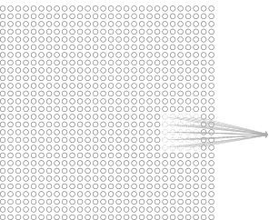
Local Receptive field
Each neuron in the first hidden layer will be connected to a small region of the input neurons
Hidden neuron
The region in the input image is called the local receptive field for the hidden neuron.
Each connection learns a weight.

Slide 22
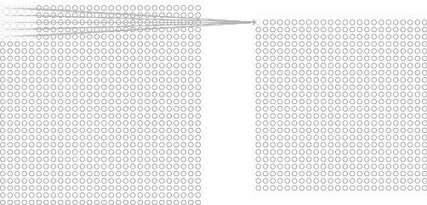
Hidden Layer
Slide the local receptive field across the entire input image and by sliding one pixel to the right (i.e., by one neuron), connect to a second hidden neuron and so on building the first hidden layer.
For each local receptive field, there is a different hidden neuron in the first hidden layer.
First Hidden layer
A different stride length is also used

Slide 23
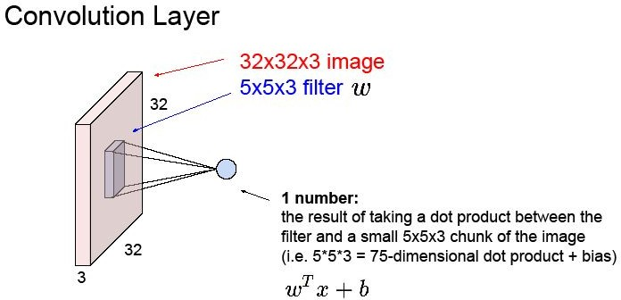

Slide 24

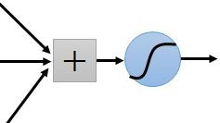
Learning an image:
Can represent a small region with fewer parameters
“beak” detector

Slide 25

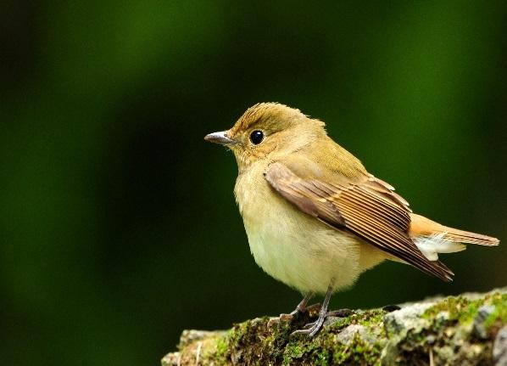
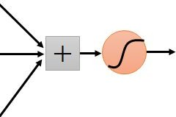


Same pattern appears in different places: They can be compressed!
What about training a lot of such “small” detectors and each detector must “move around”.
“upper-left beak” detector
They can be compressed to the same parameters.
“middle beak” detector

Slide 26
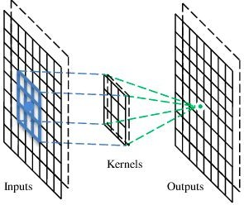
A convolutional layer
A convolutional layer has a number of filters that does convolutional operation.
Beak detector
A filter

Slide 27
Convolution
These are the network parameters to be learned.
1 -1 -1
-1 1 -1
-1 -1 1
1 | 0 | 0 | 0 | 0 | 1
0 | 1 | 0 | 0 | 1 | 0
0 | 0 | 1 | 1 | 0 | 0
1 | 0 | 0 | 0 | 1 | 0
0 | 1 | 0 | 0 | 1 | 0
0 | 0 | 1 | 0 | 1 | 0
Filter 1
-1 1 -1
-1 1 -1
-1 1 -1
Filter 2
…
…
6 x 6 image
Each filter detects a small pattern (3 x 3).

Slide 28



1 -1 -1
Convolution
stride=1
-1 1 -1
-1 -1 1
Filter 1
0 1
1 0
0 0
1 0 0 0 1 0
0 1 0 0 1 0
0 0 1 0 1 0
1 | 0 | 0 | 0
0 | 1 | 0 | 0
0 | 0 | 1 | 1
Dot product
3
-1
6 x 6 image

Slide 29














Convolution
1 | -1 | -1
-1 | 1 | -1
-1 | -1 | 1
Filter 1
stride=1
1 | 0 | 0 | 0 | 0 | 1
0 | 1 | 0 | 0 | 1 | 0
0 | 0 | 1 | 1 | 0 | 0
1 | 0 | 0 | 0 | 1 | 0
0 | 1 | 0 | 0 | 1 | 0
0 | 0 | 1 | 0 | 1 | 0
3 | -1 | -3 | -1
-3 | 1 | 0 | -3
-3 | -3 | 0 | 1
3 | -2 | -2 | -1
6 x 6 image

Slide 30

1 -1 -1
Convolution
If stride=2
-1 1 -1
-1 -1 1
Filter 1
1
0
0
1 0 0 0 1 0
0 1 0 0 1 0
0 0 1 0 1 0
1 | 0 | 0 | 0 | 0
0 | 1 | 0 | 0 | 1
0 | 0 | 1 | 1 | 0
3
-3
6 x 6 image

Slide 31

















Convolution
-1 | 1 | -1
-1 | 1 | -1 | Filter 2
-1 | 1 | -1
stride=1
Repeat this for each filter
1 | 0 | 0 | 0 | 0 | 1
0 | 1 | 0 | 0 | 1 | 0
0 | 0 | 1 | 1 | 0 | 0
1 | 0 | 0 | 0 | 1 | 0
0 | 1 | 0 | 0 | 1 | 0
0 | 0 | 1 | 0 | 1 | 0
3 -1 | -1 -1 | -3 -1 | -1 -1
-3 | 1 | 0 | -3
-
1 -1 -2
-3 0 1
1
Feature Map
-1 -2
-3
-1
1
6 x 6 image
3
-2 -2 -1
0 -4 3
Two 4 x 4 images
Forming 2 x 4 x 4 matrix
-1

Slide 32
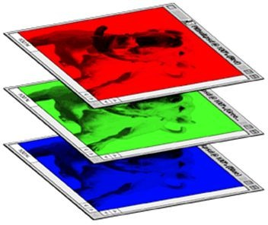
Color image: RGB 3 channels
1 | -1 | -1 |  | -1 | 1 | -1
-1 | 1 | -1 | Filter 1 | -1 | 1 | -1
-1 | -1 | 1 |  | -1 | 1 | -1
1
-1
-1
-1
-1
1
1
-1
-1
1
-1
-1
-1
1
-1
-1
-1
1
1
-1
-1
-1
1
-1
Filter 2
-1
-1
1
-1
-1
1
1
-1
-1
-1
-1
1
Color image
1
0
0
0
0
1
1
0
0
0
0
1
0
1 | 0 | 0 | 0 | 0 | 1
0 | 1 | 0 | 0 | 1 | 0
0 | 0 | 1 | 1 | 0 | 0
1 | 0 | 0 | 0 | 1 | 0
0 | 1 | 0 | 0 | 1 | 0
0 | 0 | 1 | 0 | 1 | 0
1
0
0
1
0
0
1
0
0
1
0
0
0
1
1
0
0
0
0
1
1
0
0
1
0
0
0
1
0
1
0
0
0
1
0
0
1
0
0
1
0
0
1
0
0
1
0
0
0
1
0
1
0
0
0
1
0
1
0

Slide 33
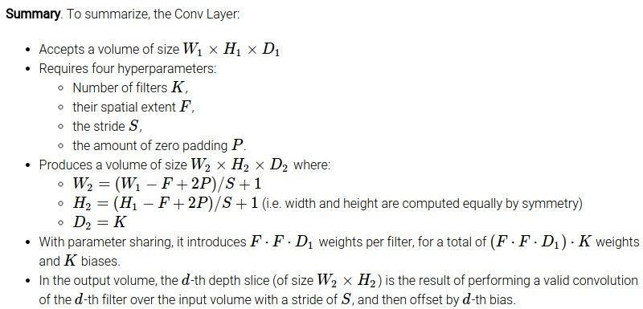

Slide 34
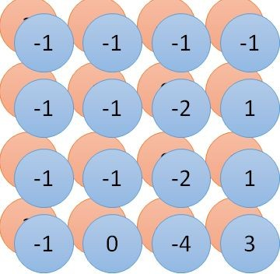












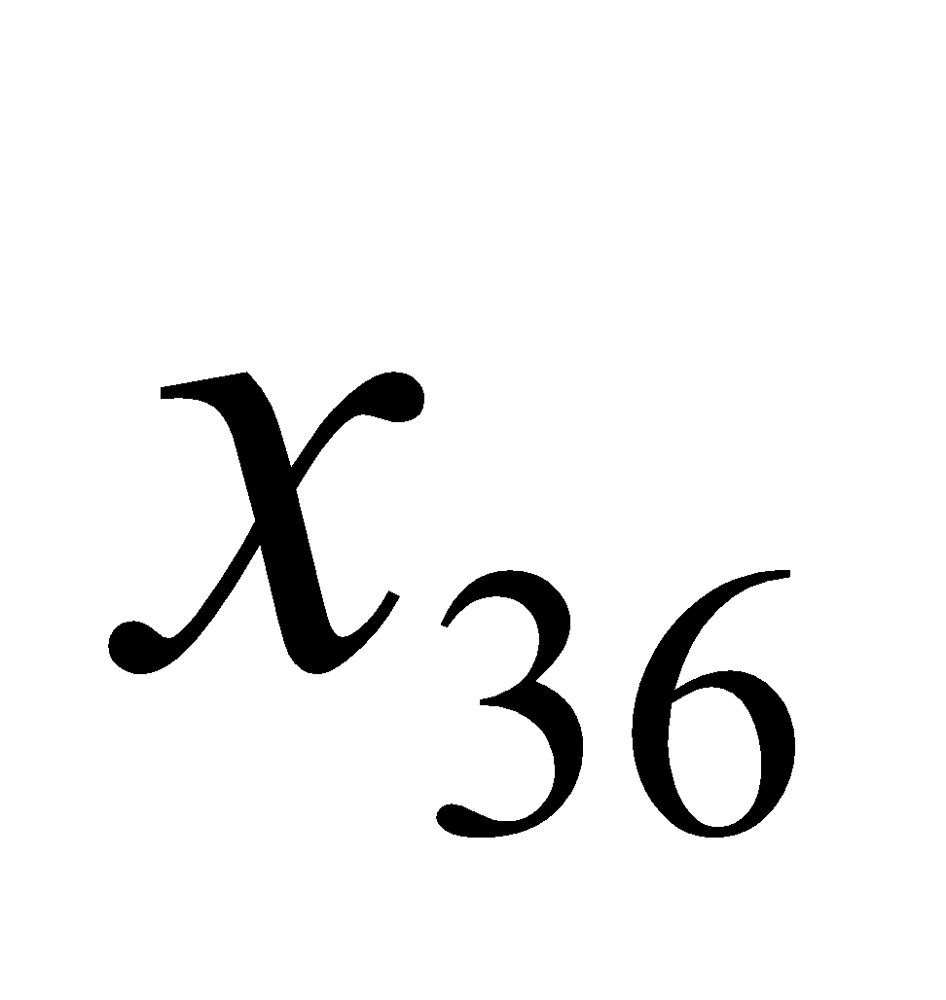

Convolution v.s. Fully Connected
1 | 0 | 0 | 0 | 0 | 1
0 | 1 | 0 | 0 | 1 | 0
0 | 0 | 1 | 1 | 0 | 0
1 | 0 | 0 | 0 | 1 | 0
0 | 1 | 0 | 0 | 1 | 0
0 | 0 | 1 | 0 | 1 | 0
1 | -1 | -1 |  | -1 | 1 | -1
-1 | 1 | -1 |  | -1 | 1 | -1
-1 | -1 | 1 |  | -1 | 1 | -1
convolution
image
fewer parameters!
1 | 0 | 0 | 0 | 0 | 1
0 | 1 | 0 | 0 | 1 | 0
0 | 0 | 1 | 1 | 0 | 0
1 | 0 | 0 | 0 | 1 | 0
0 | 1 | 0 | 0 | 1 | 0
0 | 0 | 1 | 0 | 1 | 0
Fully-conne cted
…
…
…
…

Slide 35
Convolution and Shallow NN
Convolutional Neural Networks are very similar to regular Neural Networks.
CNN are made up of neurons that have learnable weights and biases, updated using loss function.
Each neuron receives inputs, performs a dot product and follows with a non-linearity.
The CNN has an activation function (e.g. sigmoid/Softmax) on the last (fully-connected) layer and all steps of learning regular Neural Networks still apply.

Slide 36
So what does change?
It makes the forward function more efficient to implement and vastly reduce the amount of parameters in the network.
Regular Neural Nets don’t scale well to full images.
For example, an image of size, 200×200×3 (200 wide,
200 high, 3 color channels), would lead to a single fully-connected neuron in a first hidden layer with 200×200×3 = 120,000 weights.
Full connectivity is wasteful and the huge number of parameters would quickly lead to overfitting.

Slide 37
Convolutional Neural Network
A Convolutional Neural Network (CNN) is comprised of one or more convolutional layers (often with a subsampling step) and then followed by one or more fully connected layers as in a standard multilayer neural network.
Local connections and tied weights followed by some form of
pooling results in translation invariant features.
Another benefit of CNNs is that they are easier to train and have many fewer parameters than fully connected networks with the same number of hidden units.

Slide 38
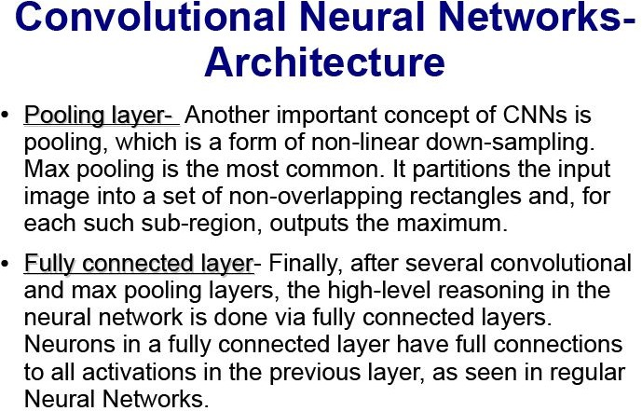

Slide 39
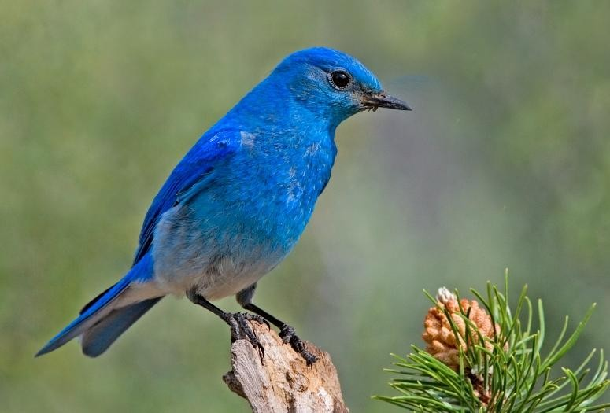
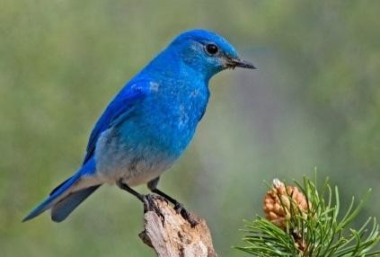
Why Pooling
Subsampling pixels will not change the object
Makes the network invariant to small transformations, distortions and translations in the input image
Subsampling
We can subsample the pixels to make image smaller Fewer parameters to characterize the image

Slide 40


















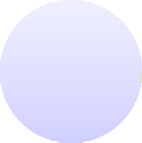








Max Pooling
1 | -1 | -1 |  | -1 | 1 | -1
-1 | 1 | -1 | Filter 1 | -1 | 1 | -1 | Filter 2
-1 | -1 | 1 |  | -1 | 1 | -1
3 | -1 |  | -3 | -1
-3 | 1 |  | 0 | -3
-3 | -3 |  | 0 | 1
3 | -2 |  | -2 | -1
-1 |  | -1 |  |  | -1 | -1
-1 |  | -1 |  |  | -2 | 1
-1 |  | -1 |  |  | -2 | 1
-1 |  | 0 |  |  | -4 | 3

Slide 41







Max Pooling
New image but smaller
3 0
-1 1
3 ₀ 1 ₃
2 x 2 image
Each filter is a channel
1 | 0 | 0 | 0 | 0 | 1
0 | 1 | 0 | 0 | 1 | 0
0 | 0 | 1 | 1 | 0 | 0
1 | 0 | 0 | 0 | 1 | 0
0 | 1 | 0 | 0 | 1 | 0
0 | 0 | 1 | 0 | 1 | 0
Conv
Max Pooling
6 x 6 image

Slide 42
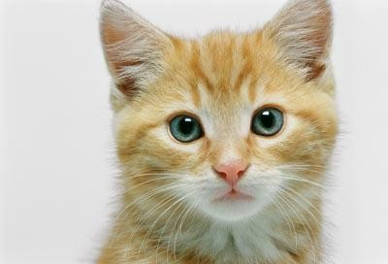


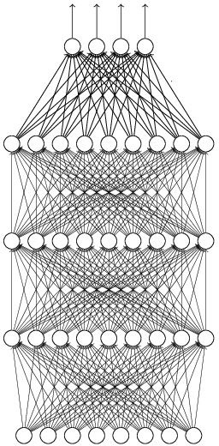







The whole CNN
cat dog ……
Convolution
Max Pooling
Can repeat many times
Fully Connected Feedforward network
Convolution
Max Pooling
Flattened

Slide 43















The whole CNN
0 ₁
3 ₀ 1 ₃
3
-1
Convolution
Max Pooling
Can repeat many times
A new image
Convolution
Smaller than the original image
The number of channels is the number of filters
Max Pooling

Slide 44
Fully Connected Layer of CNN
The Fully Connected layer is a traditional Multi Layer Perceptron that uses a softmax activation function in the output layer.
The term “Fully Connected” implies that every neuron in the previous layer is connected to every neuron on the next layer.
The output from the convolutional and pooling layers represent high-level features of the input image.
The purpose of the Fully Connected layer is to use these features for classifying the input image into various classes based on the training dataset.

Slide 45




The whole CNN
cat dog ……
Convolution
Max Pooling
Fully Connected Feedforward network
A new image
Convolution
Max Pooling
Flattened
A new image

Slide 46


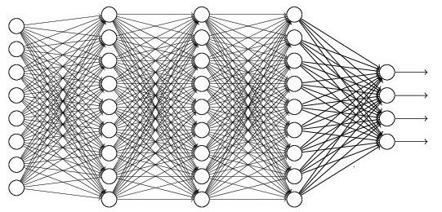















Flattening
3
0
1
3
-1
0
1
3
3 ₀ 1 ₃
-1
Flattened
Fully Connected Feedforward network
1
0
3

Slide 47
A CNN compresses a fully connected network in two ways:
Reducing number of connections
Shared weights on the edges
Max pooling further reduces the complexity

Slide 48

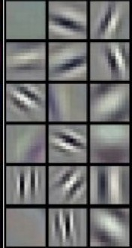
















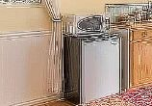


Deep Learning
Deep learning has an inbuilt automatic multi stage feature learning process that learns rich hierarchical representations (i.e. features).
Low Level Features
Mid Level Features
High Level Features
Trainable Classifier
Output (e.g. outdoor,
indoor)

Slide 49
LAYERS USED TO BUILD CONVNETS
A simple ConvNet is a sequence of layers.
Every layer of a ConvNet transforms one volume of activations to another through a differentiable function.
Three main types of layers to build ConvNet architectures: Convolutional Layer, Pooling Layer, and Fully-Connected Layer.
Stack these layers to form a full ConvNet architecture.

Slide 50
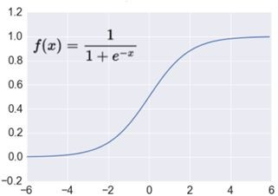
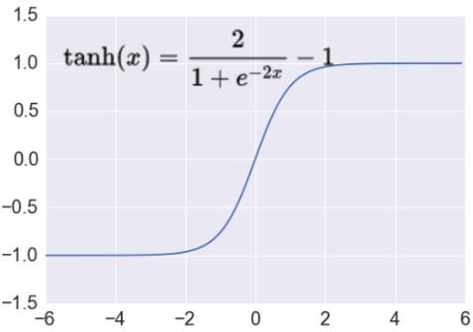
Activation Functions
Sigmoid neurons saturate and kill gradients
If initial weights are too large then most neurons would saturate
Like Sigmoid, tanh neurons saturate.
Unlike Sigmoid, tanh neurons zero centered and scaled sigmoid.

Slide 51
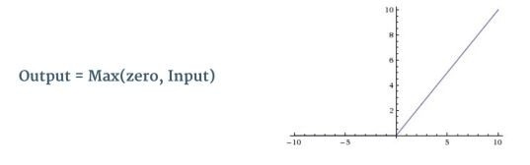

Non Linearity (ReLU)
ReLU is a non-linear operation
ReLU is an element wise operation applied per pixel and replaces all negative pixel values in the feature map by zero.
Trains much faster due to linear, nonsaturating form.
🙂 Prevents the gradient vanishing problem

Slide 52
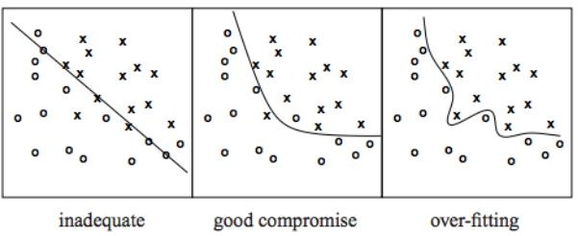
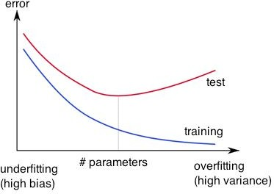
Overfitting
http://wiki.bethanycrane.com/overfitting-of-data
Learned hypothesis may fit the training data very well, even outliers (noise) but fail to generalize to new examples (test data)
https://www.neuraldesigner.com/images/learning/selection_error.svg

Slide 53
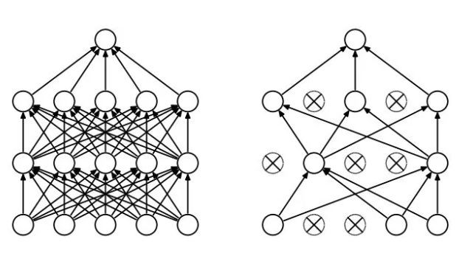
Regularization
Dropout
Randomly drop units (along with their connections) during training
Each unit retained with fixed probability p, independent of other units
Hyper-parameter p to be chosen (tuned)

Slide 54

L2 = weight decay
Regularization term that penalizes big weights, added to the objective
Weight decay value determines how dominant regularization is during gradient computation.
Big weight decay coefficient 🡪 big penalty for big weights
Early-stopping
Use validation error to decide when to stop training
Stop when monitored quantity has not improved after n subsequent epochs
n is called patience

Slide 55



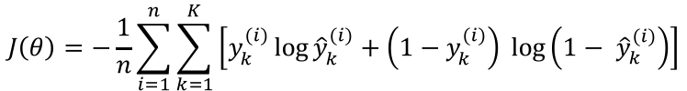

Loss functions and output
Classification Regression
Training examples
R^{n} x {class_1, ..., class_n} R^{n} x R^{m} (one-hot encoding)
Linear (Identity) or Sigmoid
Output Layer
Soft-max
[map R^{n} to a probability distribution]
f(x)=x
Cost (loss) function
Cross-entropy
Mean Squared Error
Mean Absolute Error
List of loss functions

Slide 56
How can we Train Deep Networks?
Deep networks not performing better than shallow networks using stochastic gradient descent by backpropagation.
Different layers in deep network are learning at vastly different speeds.
When later layers in the network are learning well, early layers often get stuck during training, learning almost nothing at all.
There's an intrinsic instability associated to learning by gradient descent in deep, many-layer neural networks resulting stuck at during training either at the early or the later layers.

Slide 57
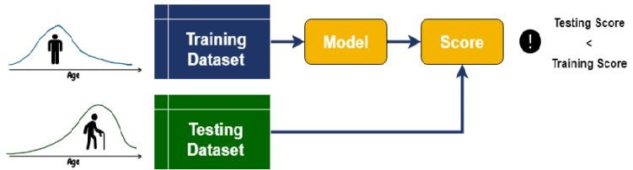
Dataset Shift
In real world problems, often train and test datasets have not been generated by the same distribution.
This phenomenon has an adversarial effect on the quality of a machine learning model, called dataset shift or drift.

Slide 58
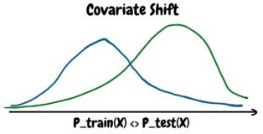
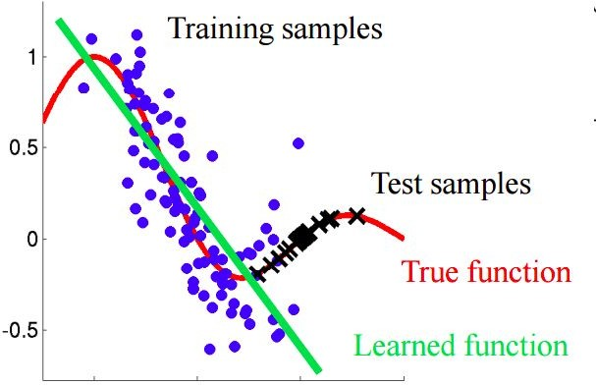
Covariate Shift
Covariate shift is the change in the distribution of the covariates specifically, that is, the independent variables.

Slide 59
Covariate shift
Mathematically, covariate shift occurs if p_{train}(X) ≠ p_{test}(X) where X is a feature.
Say, an algorithm learned some X to Y mapping, now the distribution of X changes, so we might need to retrain the learning algorithm by trying to align the distribution of X with the distribution of Y.
However, the notion of covariate shift can be extended beyond the learning system as a whole, but to apply to its parts, such as a sub-network or a layer.

Slide 60


Stochastic gradient descent(SGD)
Stochastic gradient descent (SGD) has proved an effective way of training neural networks.
SGD optimizes the parameters θ of the network, so as to minimize the loss
With SGD the training proceeds in steps and each step we consider a mini batch of size m, m << N.
The mini batch is used to approximate the gradient of the loss function w.r.t. the parameters by computing

Slide 61
Stochastic Gradient
Stochastic gradient is simple and effective, but it requires careful tuning of the model hyper-parameters.
Specifically the learning rate and the initial values for the model parameters.
The training is complicated by the fact that the inputs to each layer are affected by the parameters of all preceding layers .
Small changes to the network parameters amplify as the network becomes deeper.
The change in the distributions of layers’ inputs creates problem because the layers need to continuously adapt to the new distribution.

Slide 62

A network computing ℓ = F2(F1(u,Θ₁), Θ₂) where F1 and F2 are arbitrary transformations, and the parameters Θ₁, Θ₂ are to be learned so as to minimize the loss ℓ.
Learning Θ₂ can be viewed as if the inputs x = F1(u, Θ₁) are fed into the sub-network ℓ = F2(x, Θ₂).
A gradient descent step
for batch size m and learning rate α is exactly equivalent to that for a stand-alone network F2 with input x.
Therefore for training more efficiently – must having the same distribution between the training and test data – apply to training the sub-network as well.

Slide 63
Internal Covariate Shift
Fixed distribution of inputs to a sub-network would have positive consequences for the layers outside the subnetwork, as well.
The change in the distributions of internal nodes of a deep network, in the course of training, called Internal Covariate Shift.
Eliminating it offers a promise of faster training.
A new mechanism, call Batch Normalization reduces internal covariate shift, which accelerates the training of deep neural nets.
The goal of Batch Normalization is to achieve a stable distribution of activation values throughout training.

Slide 64
Batch Normalization
We normalize the input layer when feature have values wide spread and it speed up learning.
We do the same thing for the values in the hidden layers, and get 10 times or more improvement in the training speed.
Batch normalization reduces the amount by what the hidden unit values shift around (covariance shift).

Slide 65
Batch Normalization
The distribution of each layer’s inputs changes during training, as the parameters of the previous layers change.
In a neural network, batch normalization is achieved through a normalization step that fixes the means and variances of each layer's inputs. Zero means, unit variances.
The network becomes more robust to different initialization schemes and learning rates.

Slide 66
Batch Normalization
Batch normalization is a technique for training very deep neural networks that standardizes the inputs to a layer for each mini-batch.
Standardizing the activations of the prior layer means that assumptions the subsequent layer makes about the spread and distribution of inputs during the weight update will not change, at least not dramatically.
This has the effect of stabilizing the learning process and dramatically reducing the number of training epochs required to train deep networks.

Slide 67
Implementation
During training the mean and standard deviation of each input variable to a layer is calculated per mini-batch and used to perform the standardization.
Allow the layer to learn two new parameters, namely a new mean and standard deviation, Beta and Gamma respectively.
It allows the automatic scaling and shifting of the standardized layer inputs.
These parameters are learned along with the original model parameters, as part of the training process and restore the representation power of the network.

Slide 68
Implementation
Batch normalization may be used on the inputs to the layer before or after the activation function in the previous layer.
It may be more appropriate after the activation function if for s-shaped functions like the hyperbolic tangent and logistic function.
It may be appropriate before the activation function for activations that may result in non-Gaussian distributions like the rectified linear activation function.

Slide 69
Issues
If the mean and standard deviations for each input feature are calculated over the mini-batch instead then the batch size must be sufficiently representative of the range of each variable.
In a batch-normalized model, we have been able to achieve a training speedup from higher learning rates, with no ill side effects.
Batch normalization can make training deep networks less sensitive to the choice of weight initialization method.
Section – 8.7.1 Batch Normalization, Deep Learning, 2016.

Slide 70
Batch normalization - Summary
Batch normalization allows each layer of a network to learn by itself, independently of other layers.
Use higher learning rates because batch normalization makes sure that there’s no activation that’s gone really high or really low.
It reduces overfitting because it has a slight regularization effects.
Similar to dropout, it adds some noise to each hidden layer’s activations.
Therefore, if we use batch normalization, we will use less dropout or no drop out which is a good thing because we are not going to lose a lot of information.

Slide 71
CNN REVIEW
The motivation of using fully connected networks for image analysis with following benefits:
Fewer parameters (weights and biases)
Invariant to object translation
Capable of generalizing and learning features.
Convolutional layers are formed by filters, feature maps, and activation functions.

Slide 72
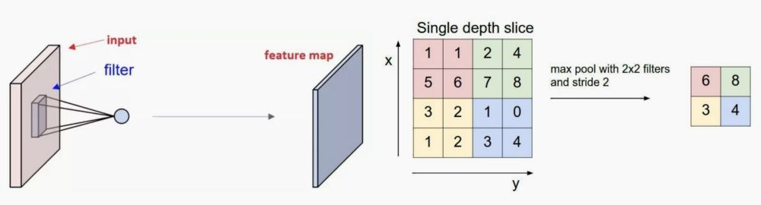

Slide 73
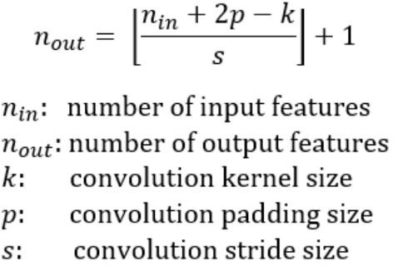
We can determine the number of output layers of a given convolutional block using number of layers in the input is nᵢ, the number of filters in that stage, f, the size of the stride, s, and the pixel dimension of the image, p(assuming it is square)

Slide 74
Layers and Features
Pooling layers are used to reduce overfitting.
Fully connected layers are used to mix spacial and channel features together.
Each of the filter layers corresponds to the image after a feature map has been drawn across the image.
which is how features are extracted.

Slide 75
Weights
It is important to know the number of input and output layers as this determines the number of weights and biases that make up the parameters of the neural network.
The more parameters in the network, the more parameters need to be trained which results in longer training time.
Training time is very important for deep learning as it a limiting factor unless you have access to powerful computing resources such as a computing cluster.

Slide 76
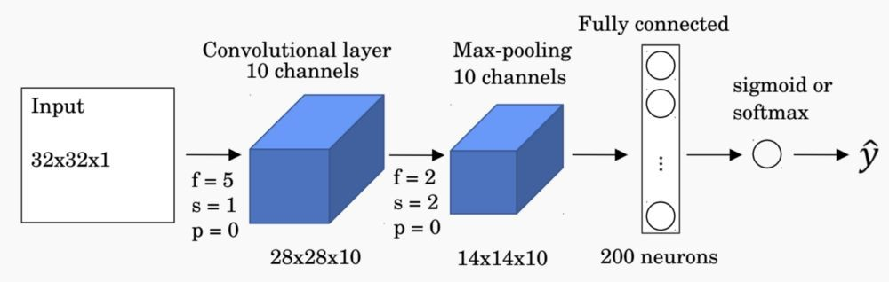
250 weights on the convolutional filter and 10 bias terms.
13 × 13 × 10 = 1,690 output elements after the max-pooling layer.
200 node fully connected layer, which results in a total of 1, 690 × 200 = 338, 000 weights and 200 bias terms in the fully connected layer.
338,460 parameters to be trained in the network. Majority of the trained parameters occur at the fully connected output layer.

Slide 77
Layer wise Complexity
Each CNN layer learns filters of increasing complexity.
The first layers learn basic feature detection filters such as edges and corners.
The middle layers learn filters that detect parts of objects — for faces, they might learn to respond to eyes and noses.
The last layers have higher representations: they learn to recognize full objects, in different shapes and positions.

Slide 78
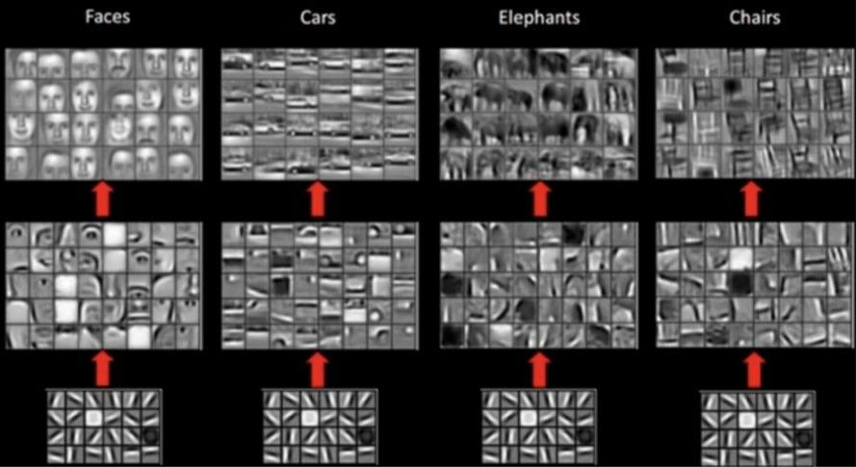
Feature maps showing increasing resolution of features through different convolutional layers of a neural network.

Slide 79
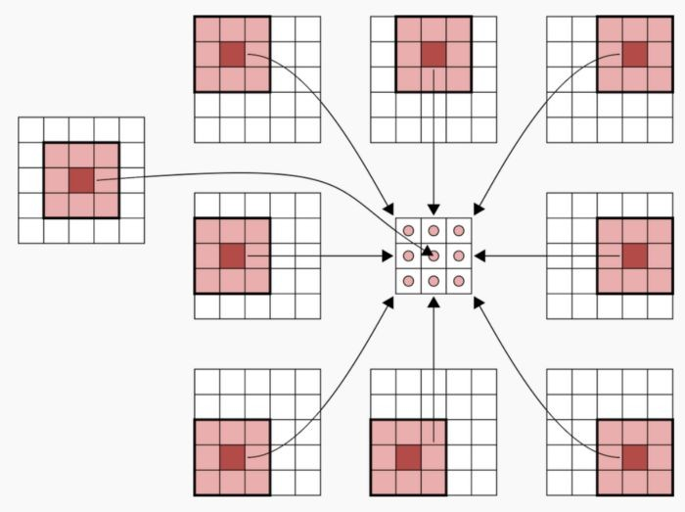
Transposed Convolution
Upsampling of a convolution step, it is called transposed convolution or fractional striding.
A typical convolutional layer with no padding, acting on an image of size 5 × 5. After the convolution, we end up with a 3
× 3 image.

Slide 80
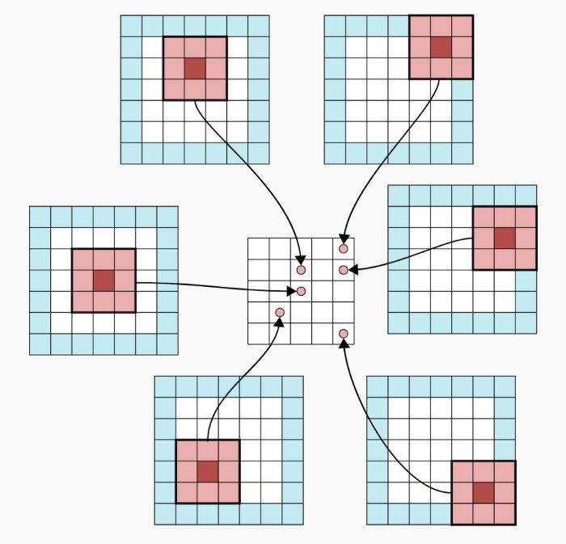
A convolutional layer with a padding of 1. The original image is 5 × 5, and the output image after the convolution is also 5 × 5.

Slide 81
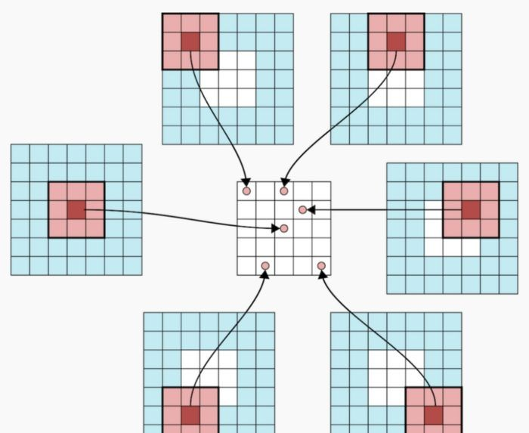
A padding of 2, original image 3× 3, and the output image after convolution 5X5
In the development of a variational autoencoder, these are implemented using an upsampling layer.

Slide 82
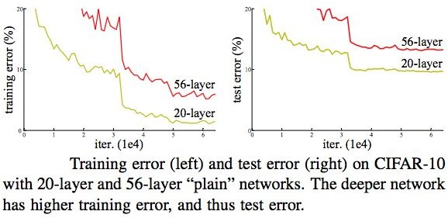
Deep Neural Networks
Classical CNNs do not perform well as the depth of the network grows past a certain threshold.
There is a maximum threshold for depth with the traditional CNN model.

Slide 83

The Residual Block NN
The failure of the 56-layer CNN could for the optimization function, parameter initialization, or vanishing/exploding gradient problem.
The problem of training very deep networks has been alleviated with the introduction of a new neural network layer
— The Residual Block.

Slide 84

Skip Connection and Identity mapping
Identity mapping does not have any parameters and is there to add the output from the previous layer to the layer ahead.
However, x and F(x) will not have the same dimension, because a convolution operation typically shrinks the spatial resolution of an image.
The identity mapping is multiplied by a linear projection W for the input x and F(x) to be combined as input to the next layer.
•
Ws term can be implemented with 1×1 convolutions,
introducing additional parameters to the model.

Slide 85

Residual Networks
The main idea behind this network is the residual block.
The network can contain 100 layers or more.

Slide 86

With this extra connection, gradients can travel backward more easily.
It becomes a flexible block that can expand the capacity of the network, or simply transform into an identity function that would not affect training.

Slide 87


Slide 88

A residual network stacks residual blocks sequentially
The idea is to allow the network to become deeper without increasing the training complexity.

Slide 89


Slide 90
Reference
Kaiming He, et al. in their 2015 paper titled “Deep Residual Learning for Image Recognition” used batch normalization after the convolutional layers in their very deep model referred to as ResNet and achieve then
state-of-the-art results on the ImageNet dataset, a standard photo classification task.

